Slide 1
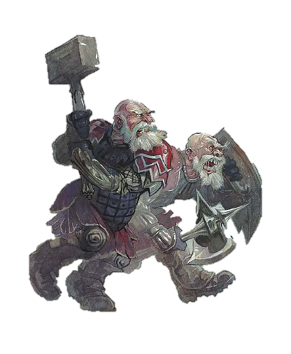
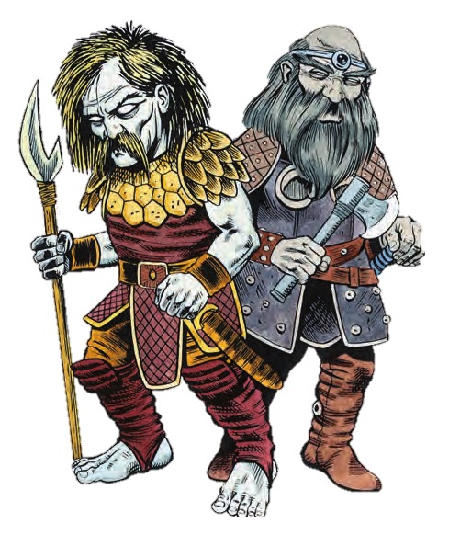

Slide 2
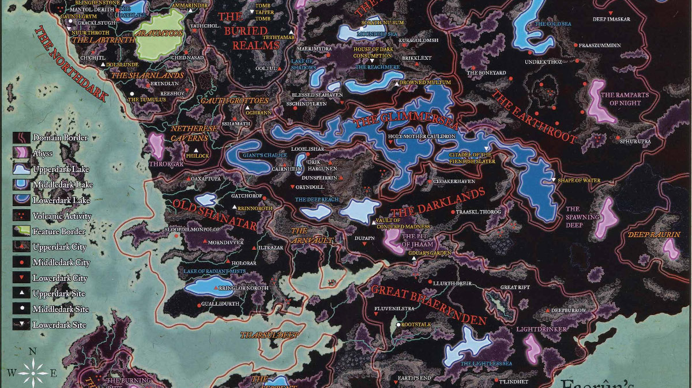
Underdark

Slide 3
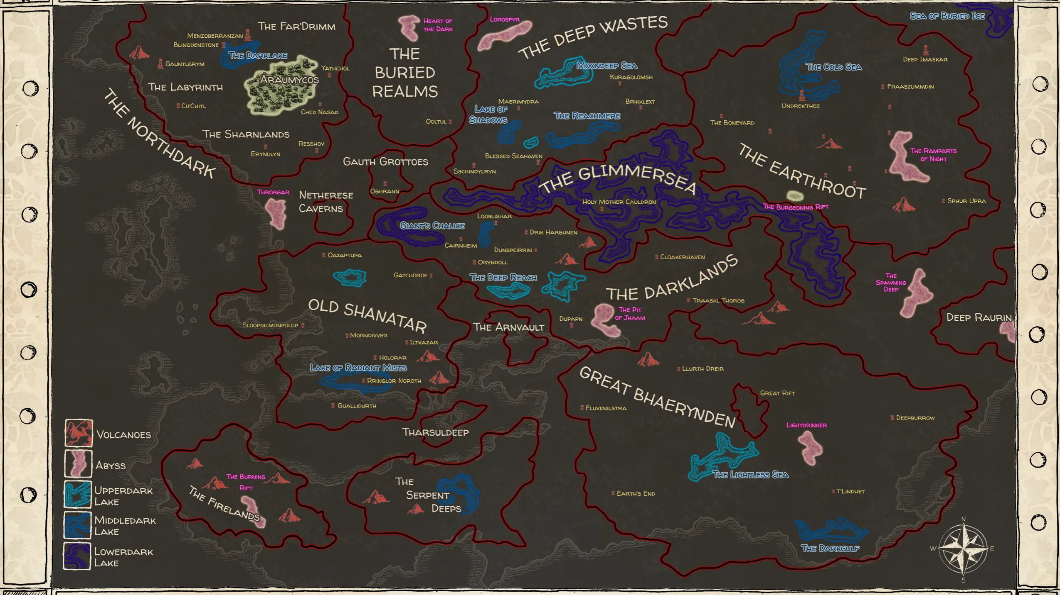

Slide 4
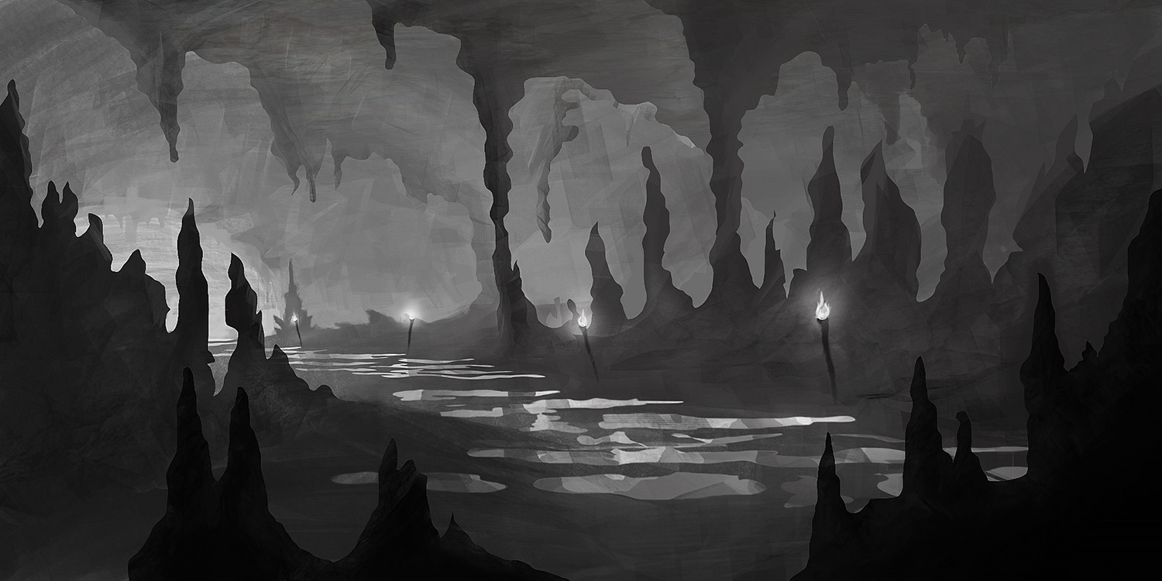
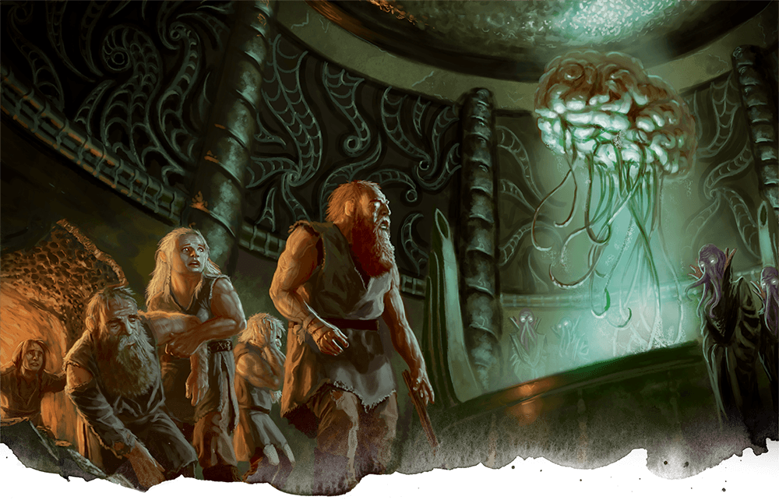

Slide 5
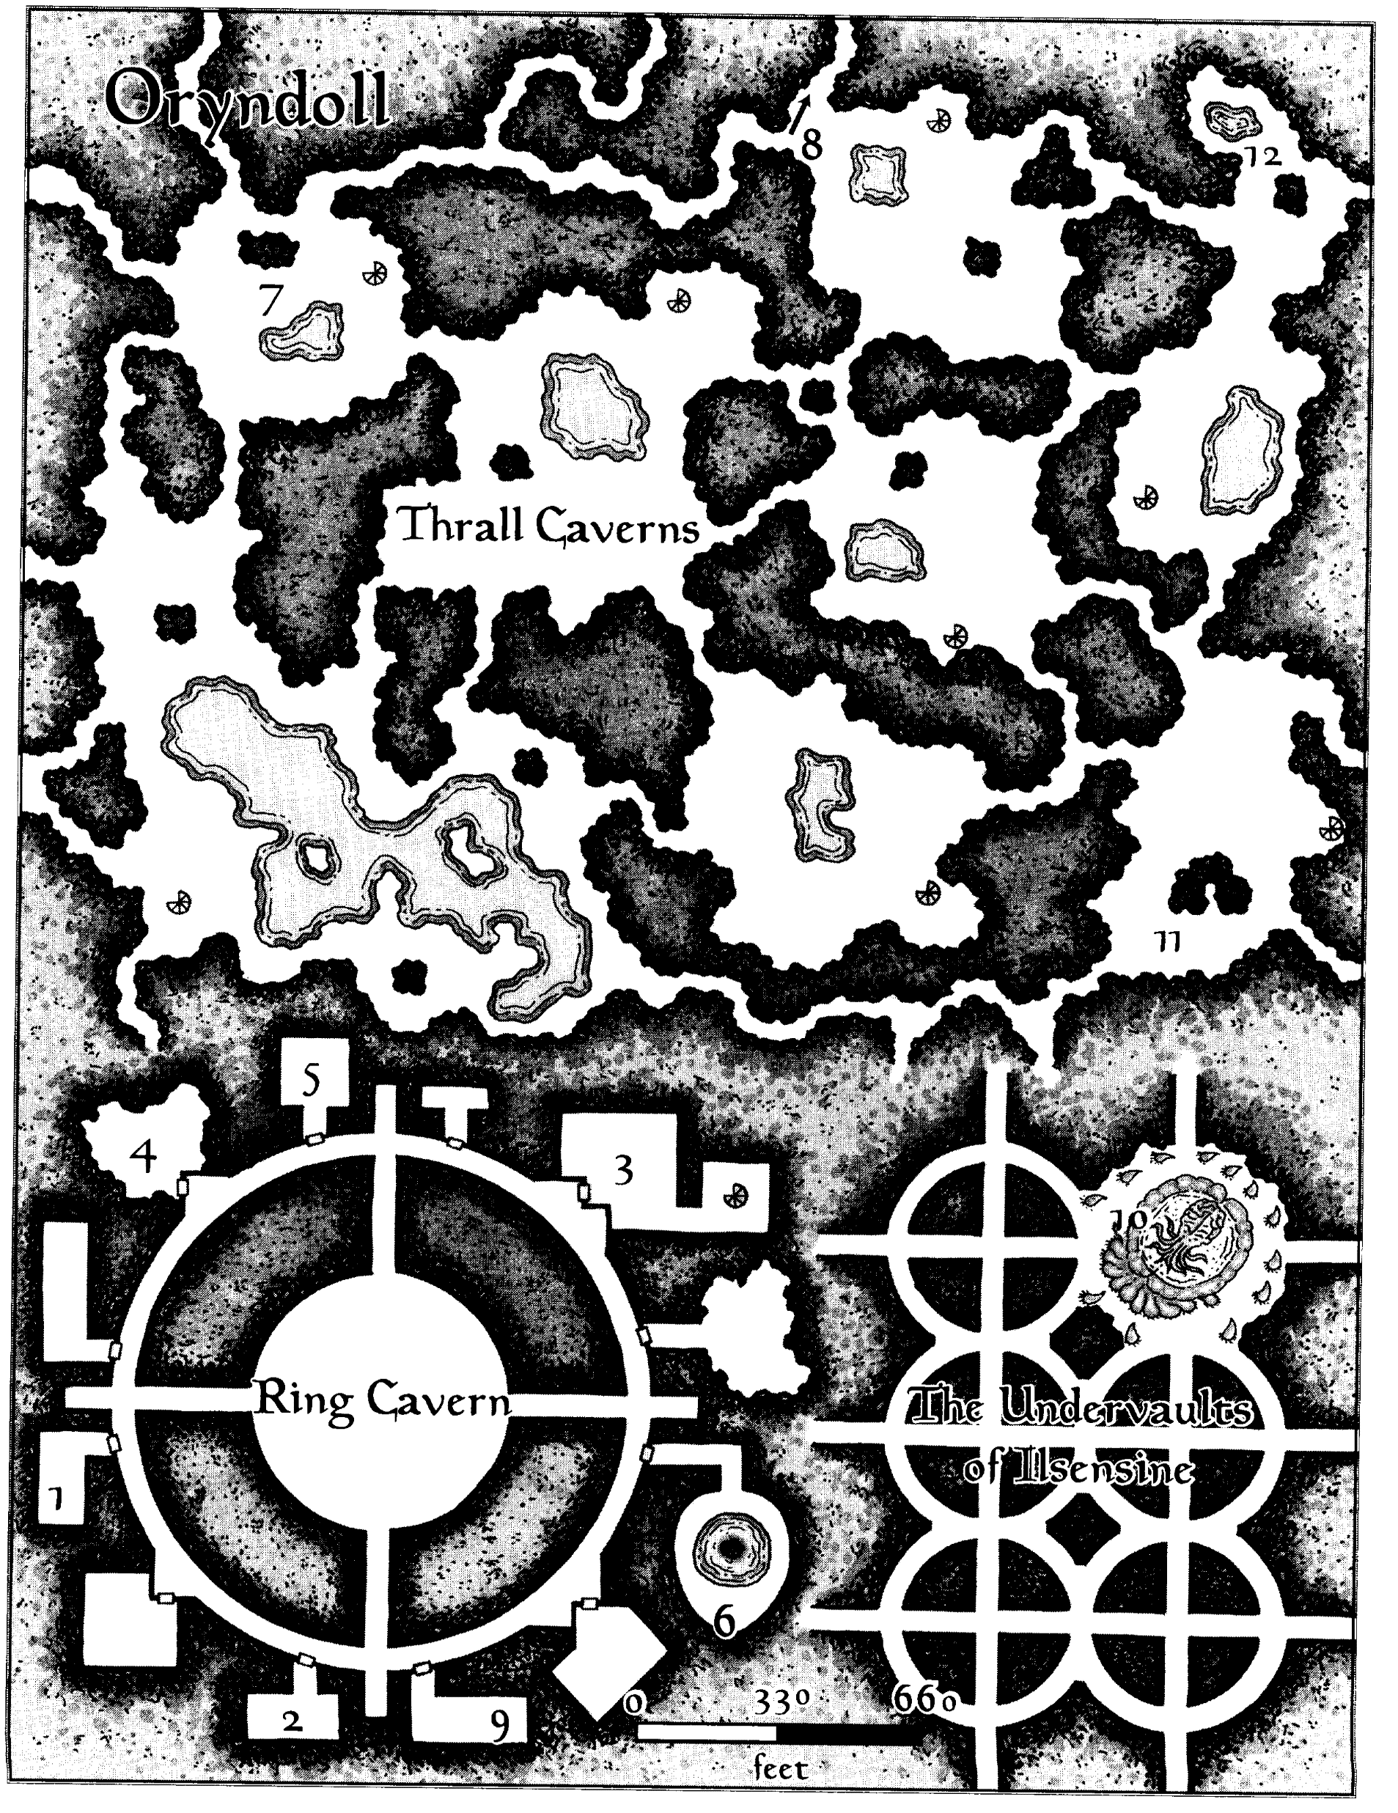
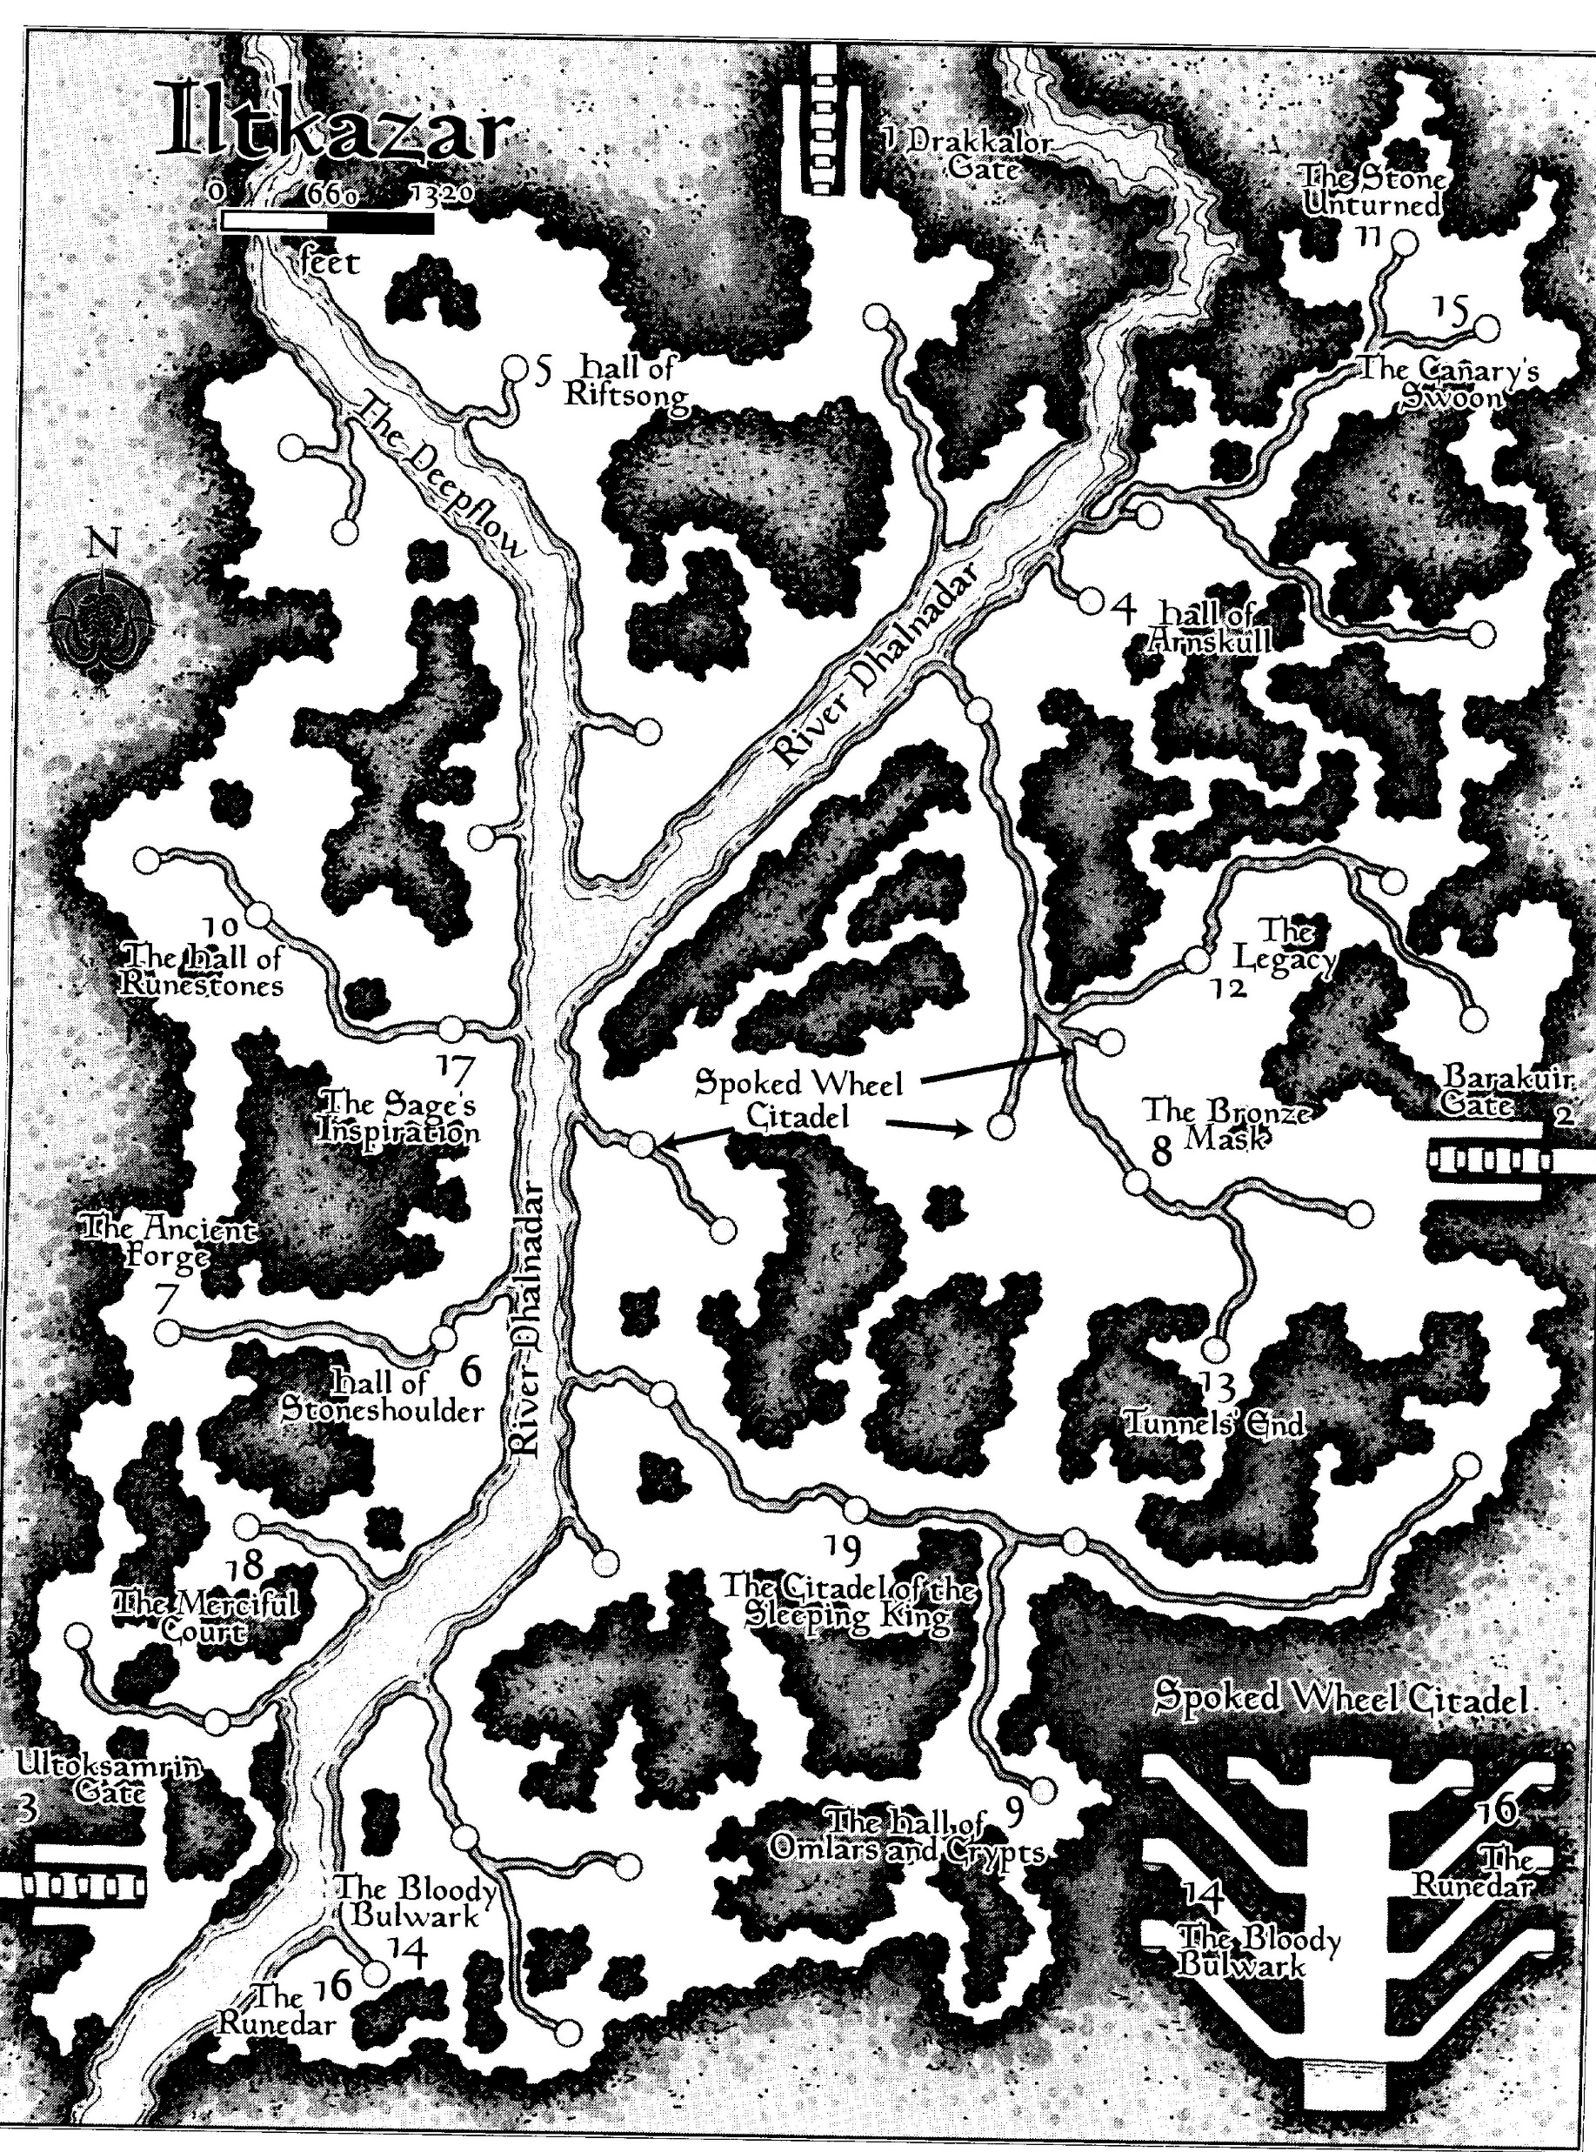

Slide 6

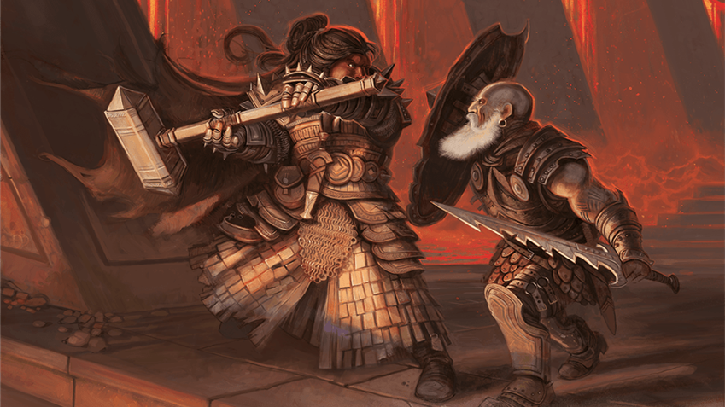
Dwarfs VS Duergars

Slide 7
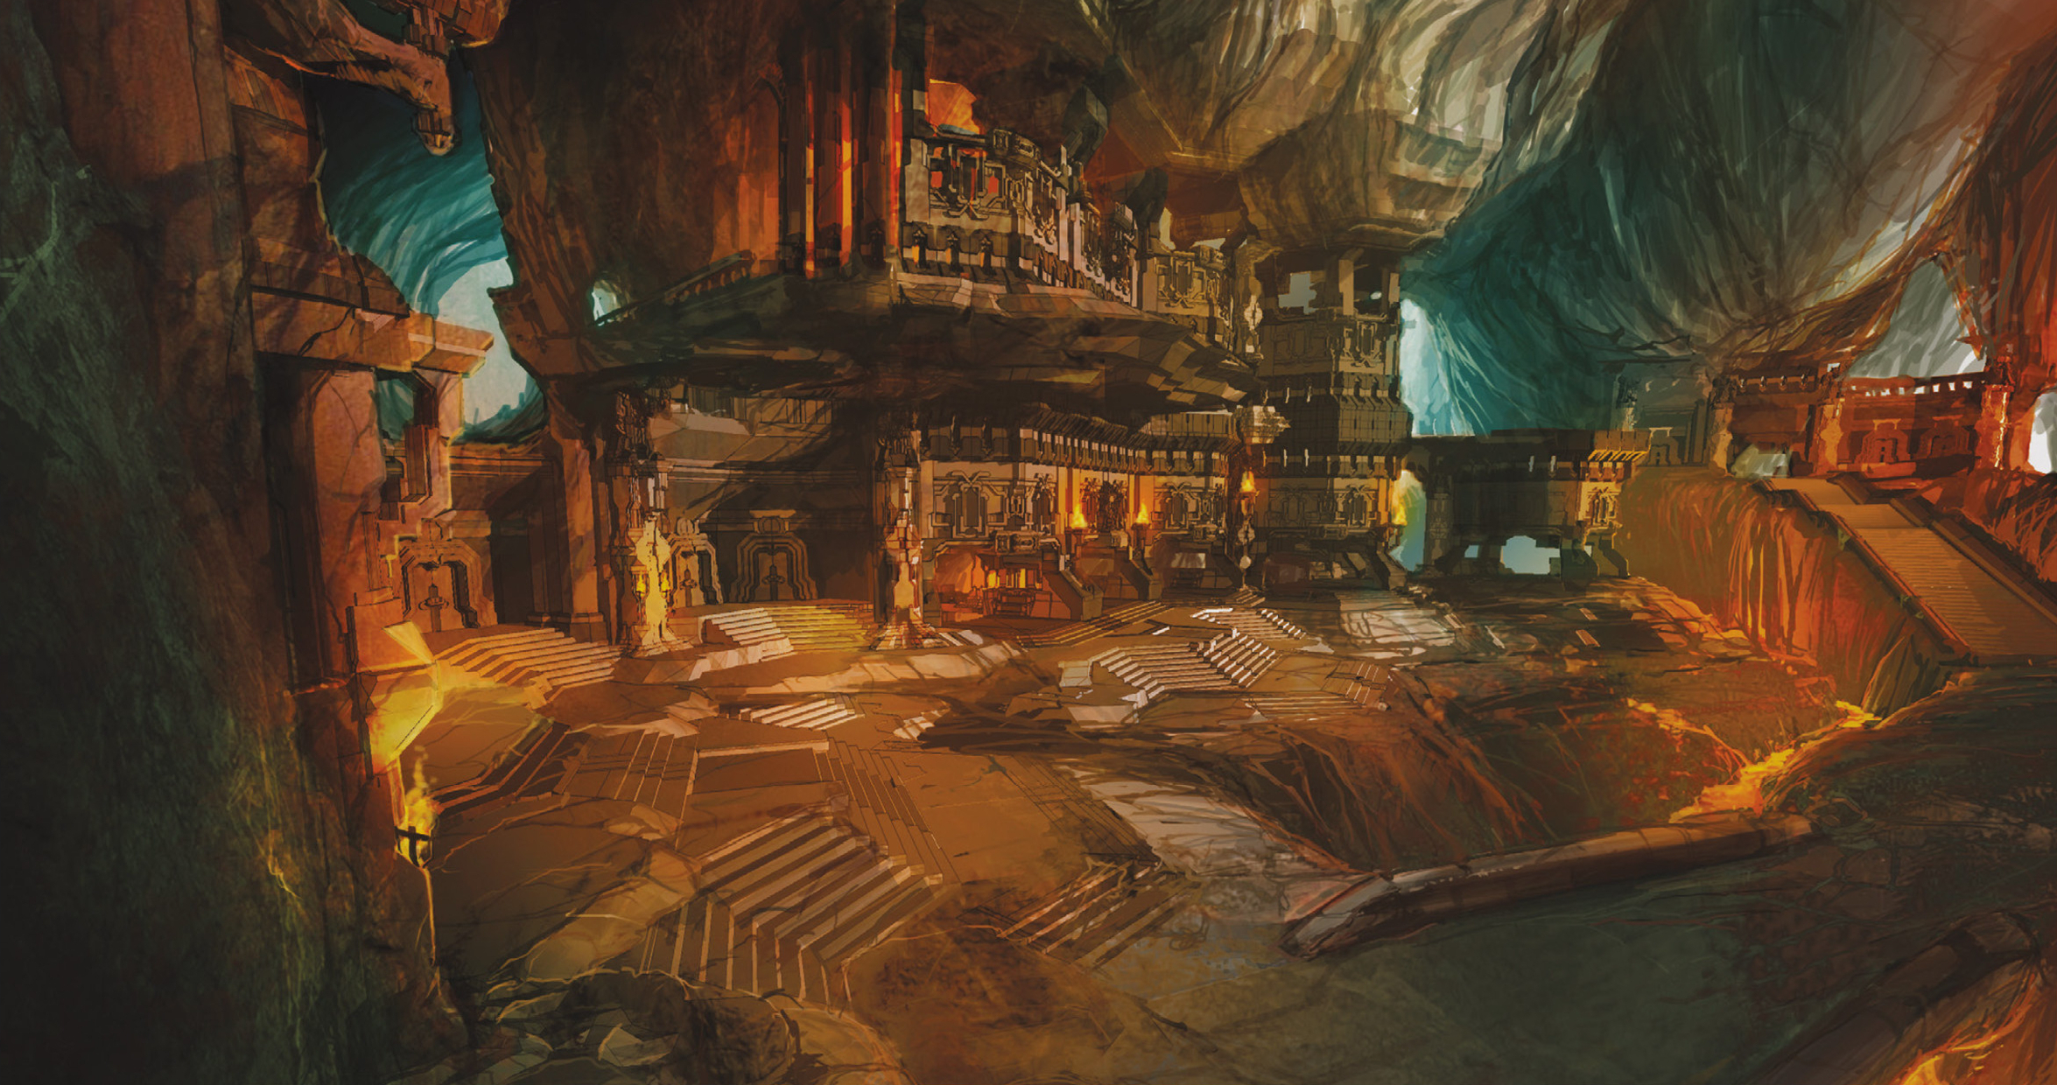
GRACKLSTUGH

Slide 8
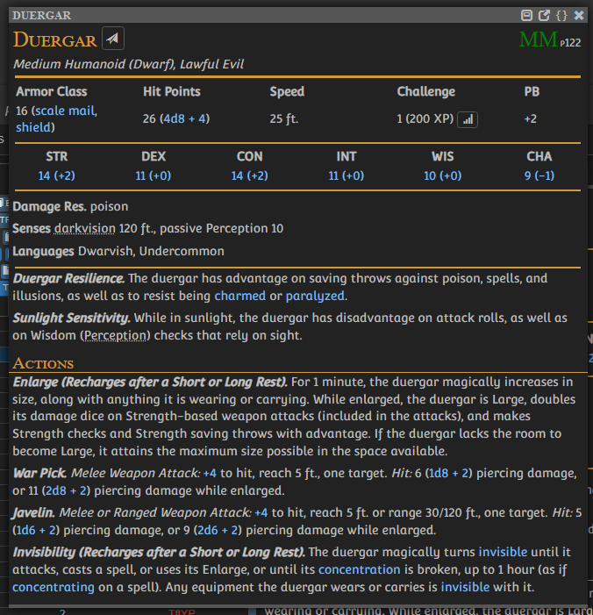
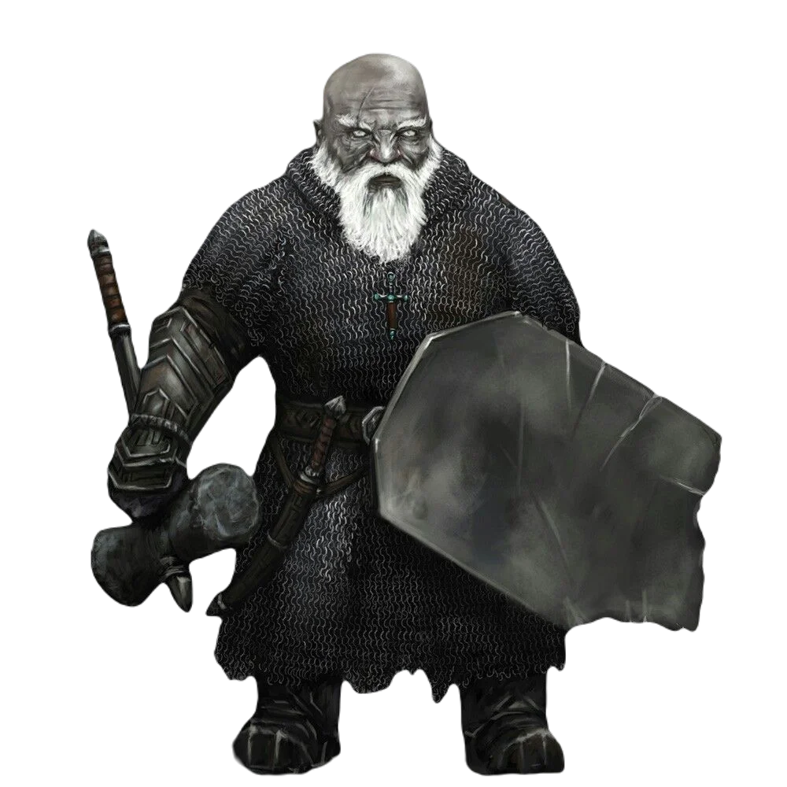

Slide 9

Сильные стороны
Высокий КЗ
Большое количество хитов
Наличие врожденных защитных свойств
Невидимость как утилитарное и тактически обогащающая особенность
Увеличение как вариативный бонус к урону
Большой радиус темного зрения

Slide 10
Слабые Стороны
Низкая скорость (25 фт, у некоторых 20 фт.)
Практическое отсутствие дальнобойных атак
?Отсутствие заклинателей поддержки
?Отсутствие боевых заклинателей с площадными заклинаниями
Боязнь солнечного света

Slide 11
УНИКАЛЬНЫЕ ОСОБЕННОСТИ
Дуэргарская фаланга - преимущество на броски атаки и спасброски Ловкости.
Кавалерия на пауках в невидимости на потолке, прыгающая на 90 футов, при этом скакун (стидер) все еще может атаковать за счет кавалерийской тренировки.

Slide 12
Сеттинговые особенности
Ненависть к дварфам
Ненависть к иллитадм
Договорные отношения с дьяволами (вплоть до скрещивания)

Slide 13
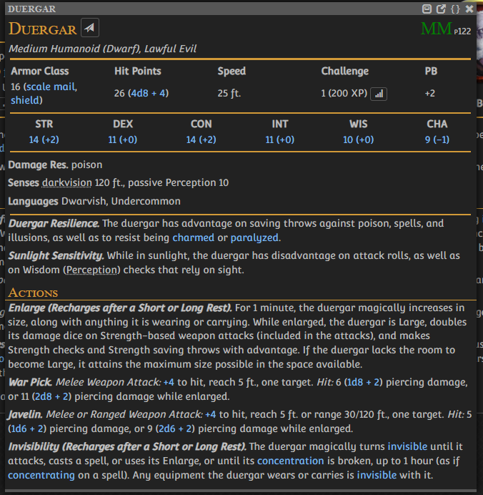

Slide 14
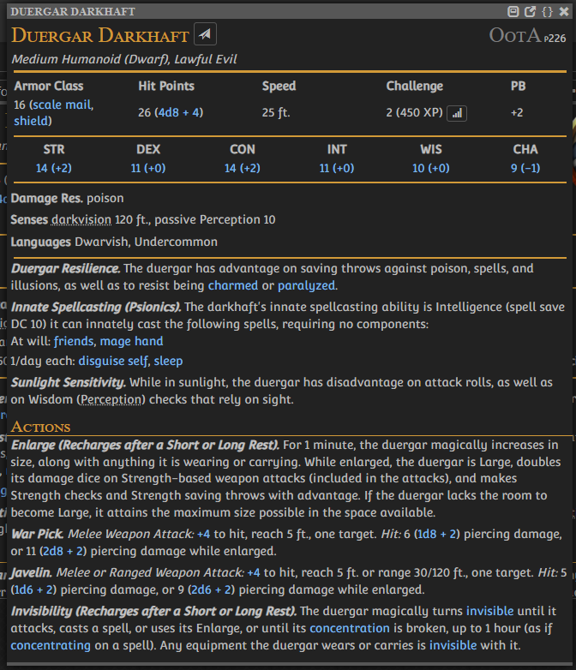

Slide 15
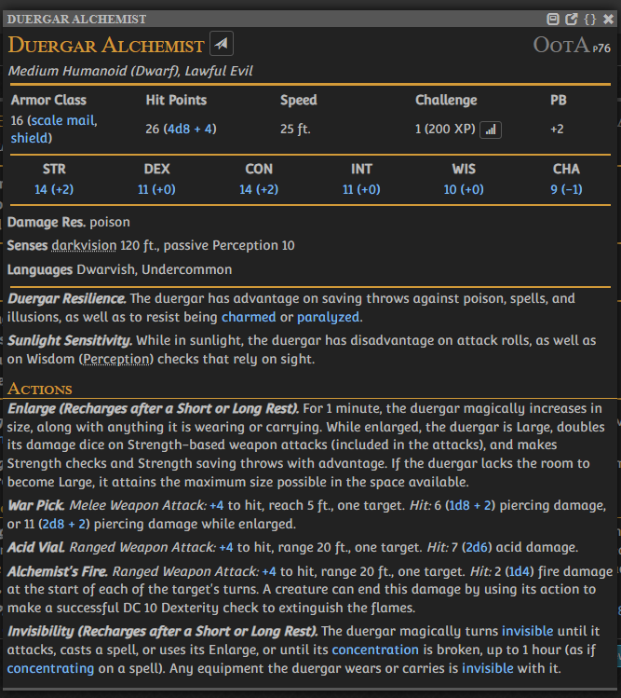
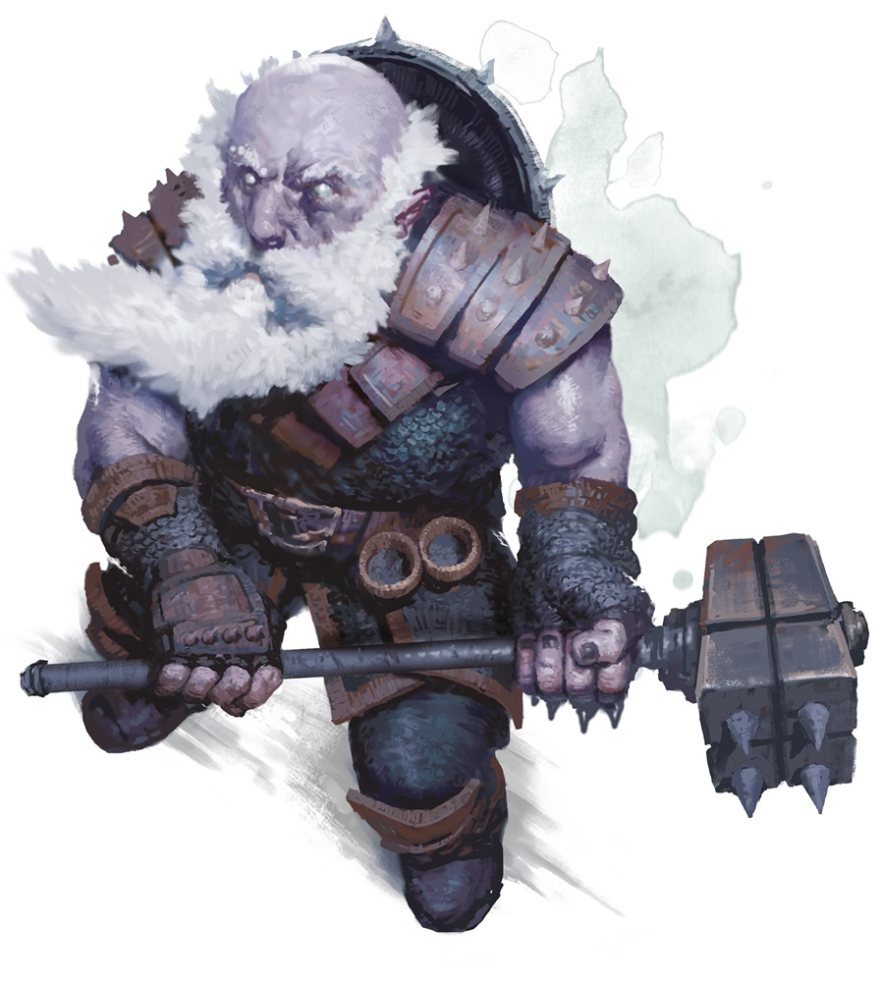

Slide 16
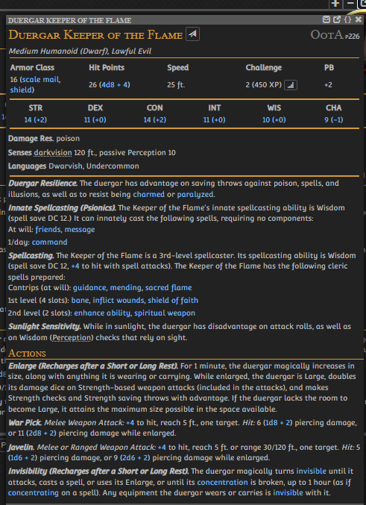
Duergar Keeper of the Flame. The Keepers of the Flame is a well-respected order of psionic clerics that serves the red dragon Themberchaud in Gracklstugh, and whose members are advisors to the Deepking.
The duergar Keeper of the Flame uses the same statistics as the duergar in the Monster Manual, except that its challenge rating is 2 (450 XP) and it has the following additional features.
Innate Spellcasting (Psionics). The Keeper of the Flame's innate spellcasting ability is Wisdom (spell save DC 12). It can innately cast the following spells, requiring no components:
At will: friends, message
3/day: command
Spellcasting. The Keeper of the Flame is a 3rd-level spellcaster. Its spellcasting ability is Wisdom (spell save DC 12, +4 to hit with spell attacks). The Keeper of the Flame has the following cleric spells prepared:
Cantrips (at will): guidance, mending, sacred flame
1st level (4 slots): bane, inflict wounds, shield of faith
2nd level (2 slots): enhance ability, spiritual weapon

Slide 17
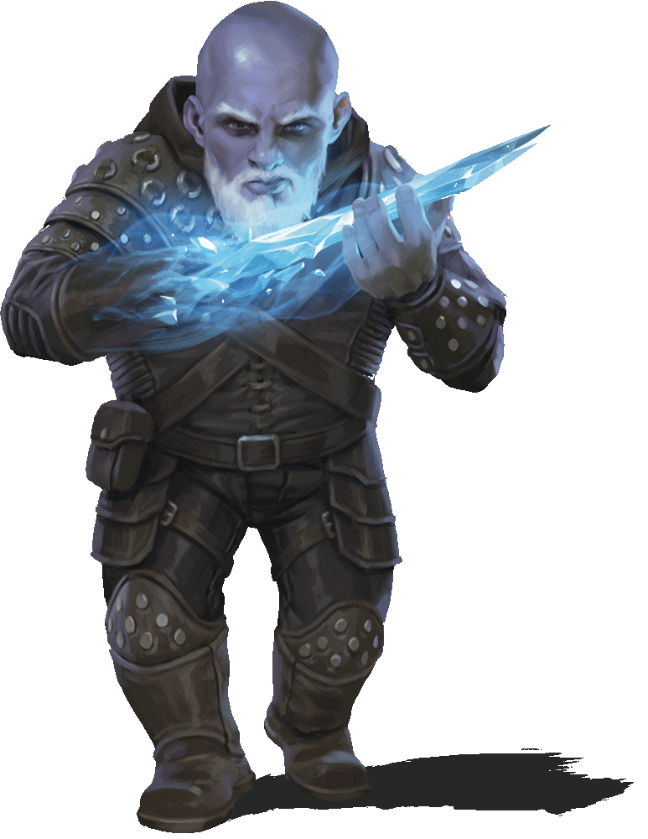
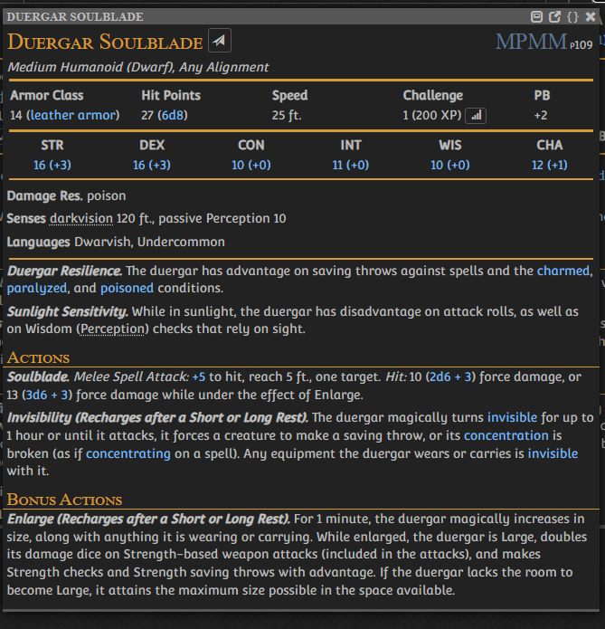

Slide 18
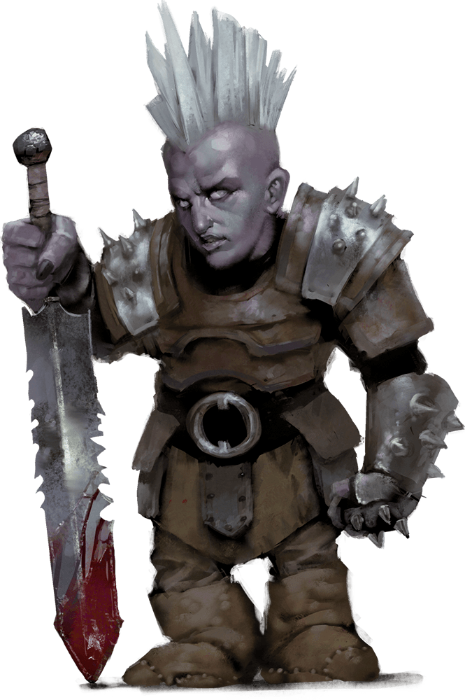
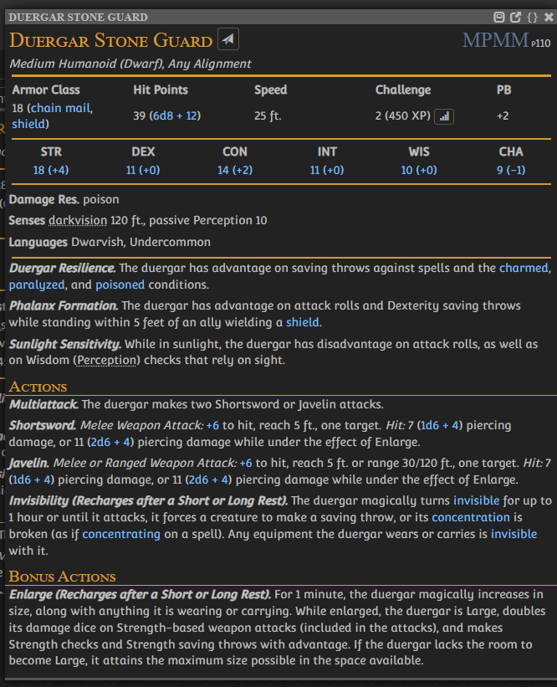
Duergar Stone Guard
Duergar Stone Guard. The stone guard are elite duergar troops, deployed in small numbers to bolster war bands of regulars or organized into elite strike forces for specific missions.
“You think dwarves are dour and unpleasant? Wait until you meet a duergar.”

Slide 19
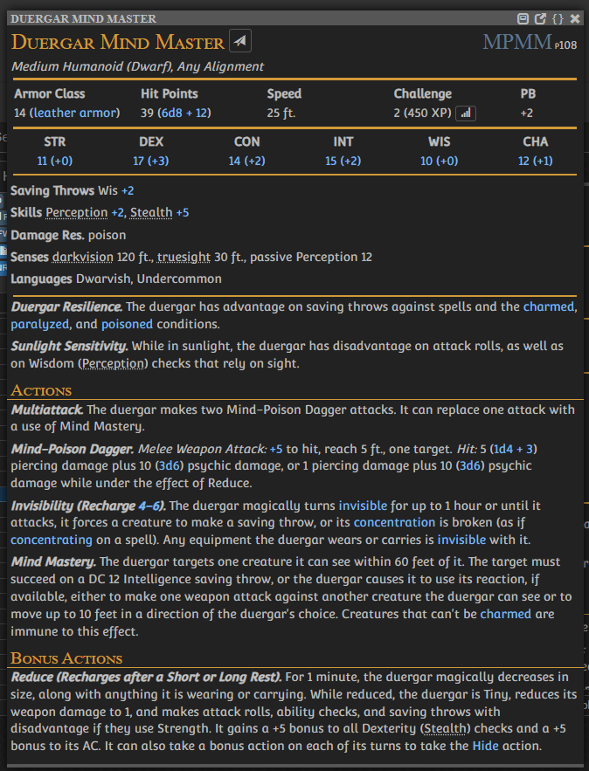
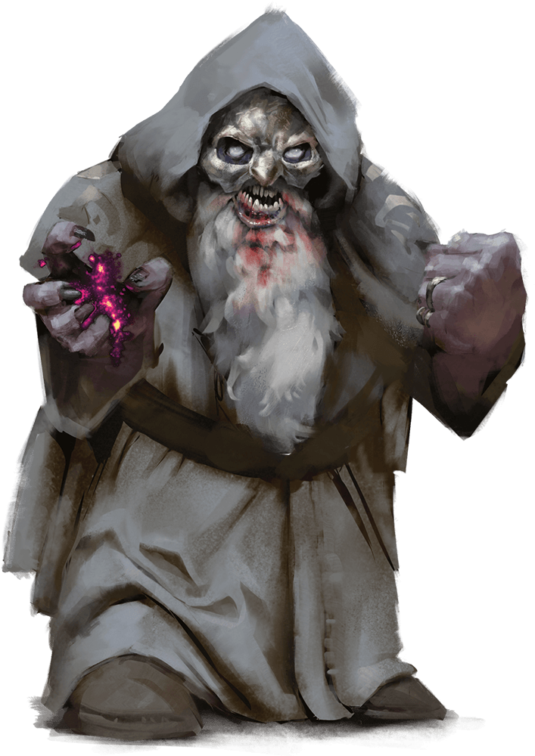
Duergar Mind Master
Wearing fearsome masks, duergar mind masters usually operate as spies, both inside and beyond a duergar stronghold. Their psionically augmented abilities enable them to see through illusions with ease and shrink down to miniature size to spy on their targets.

Slide 20
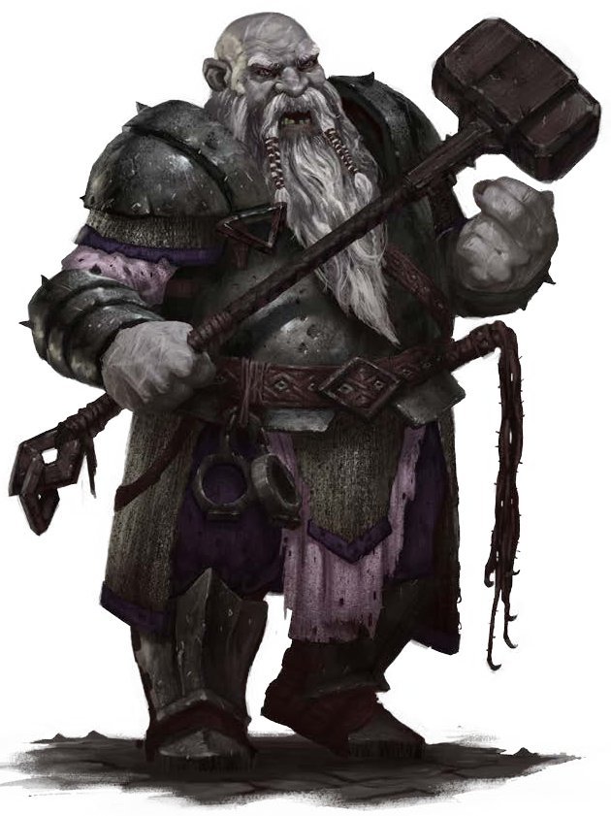

Slide 21
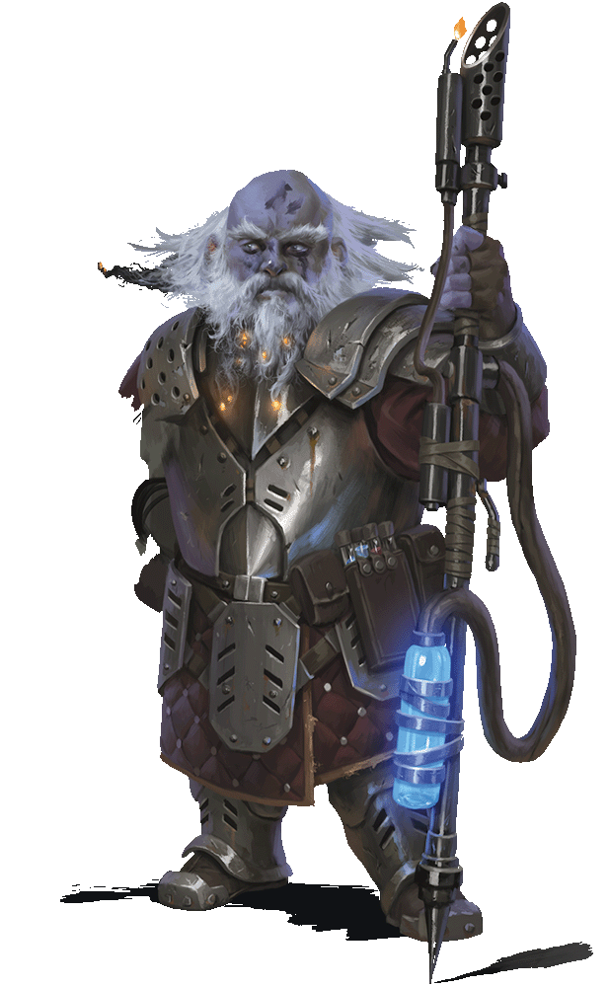
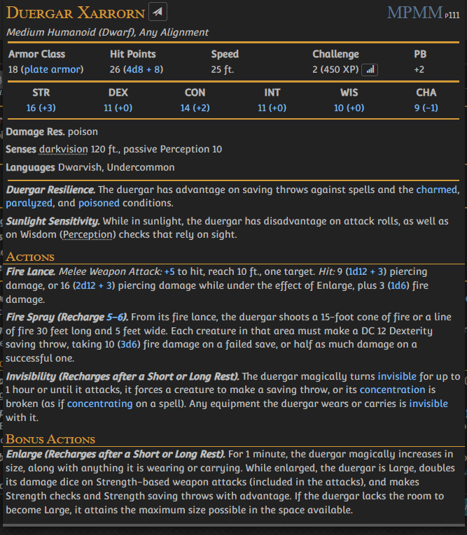

Slide 22
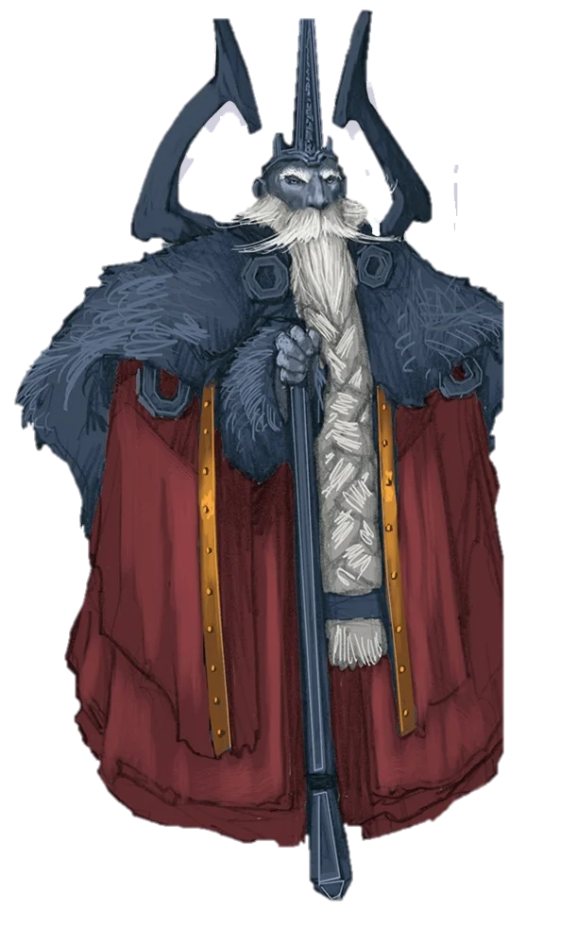
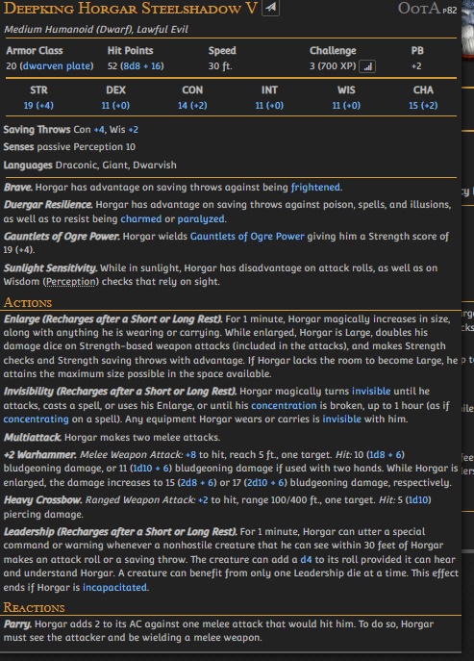

Slide 23
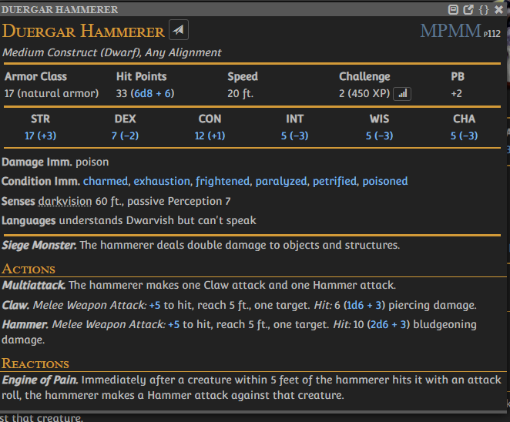
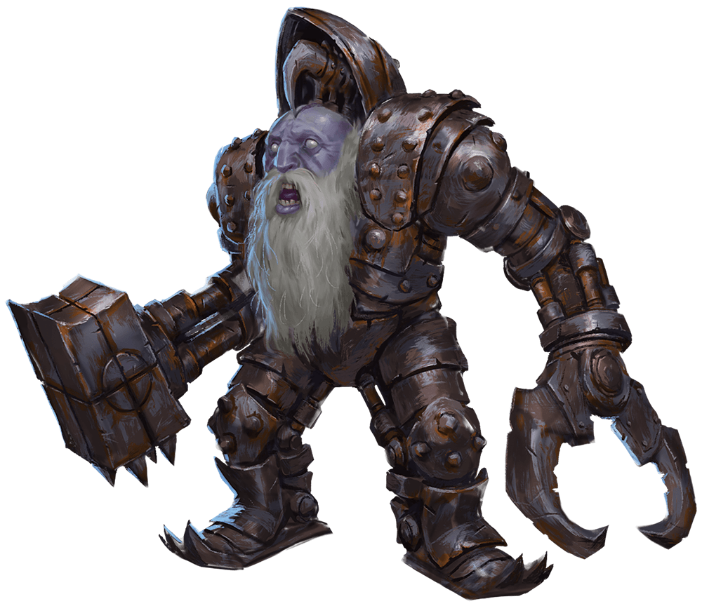
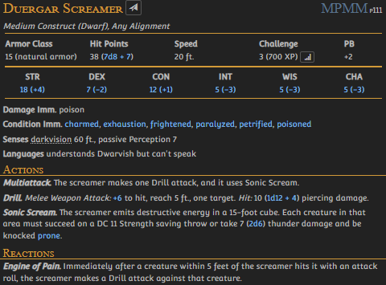

Slide 24
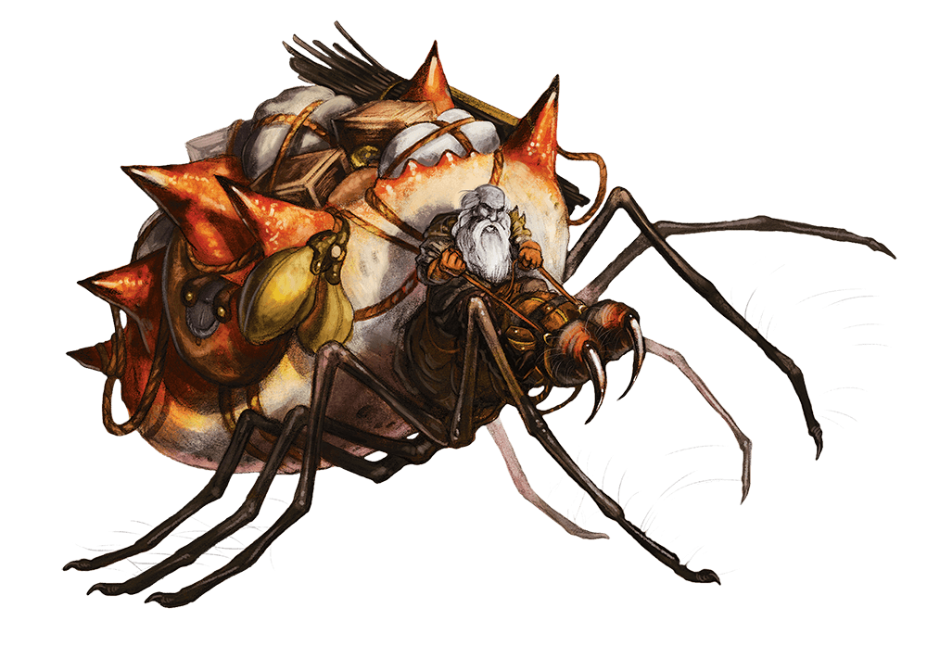
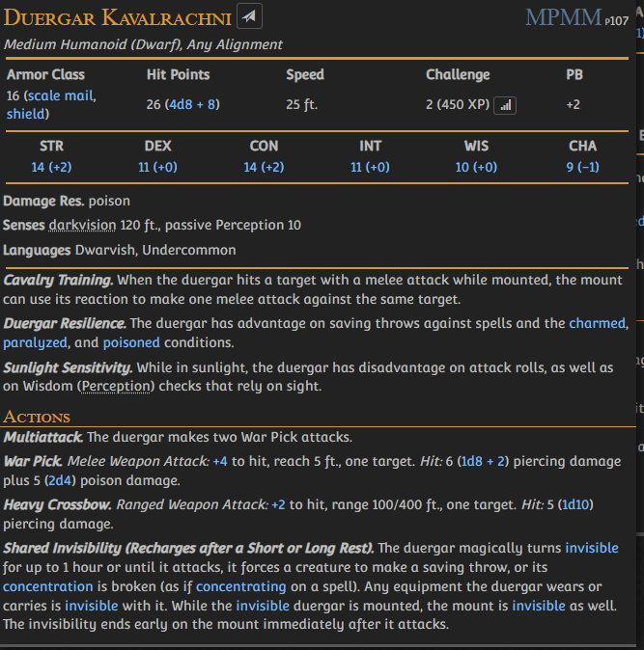

Slide 25
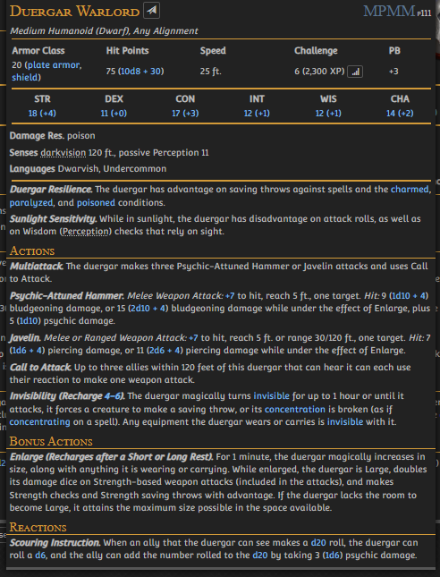
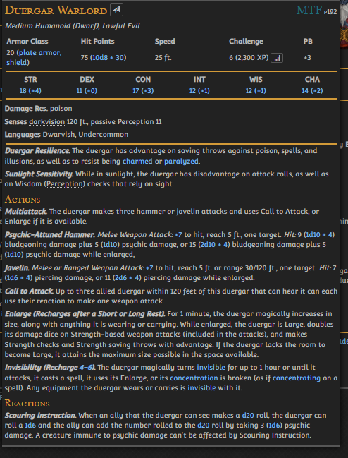

Slide 26
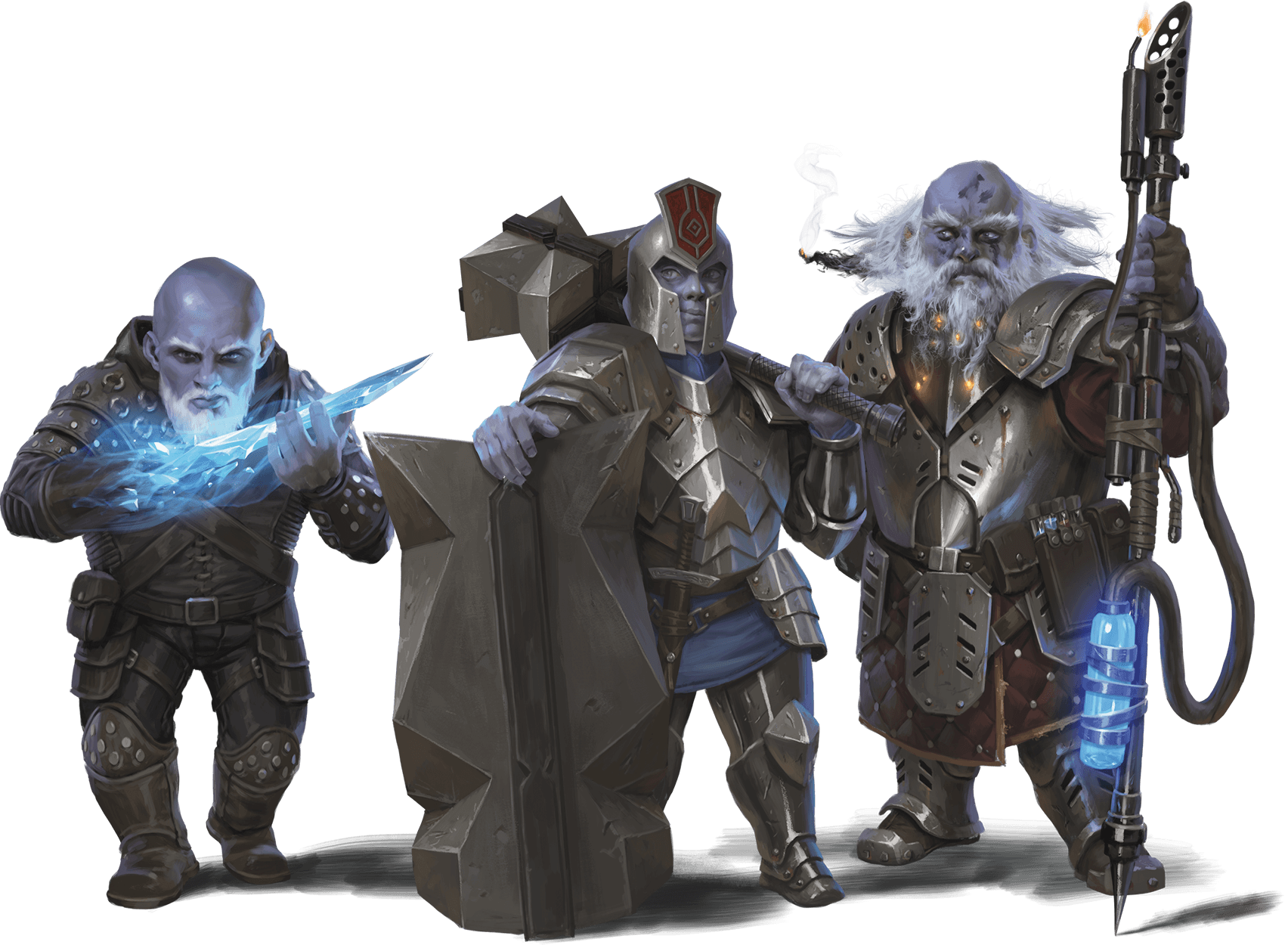
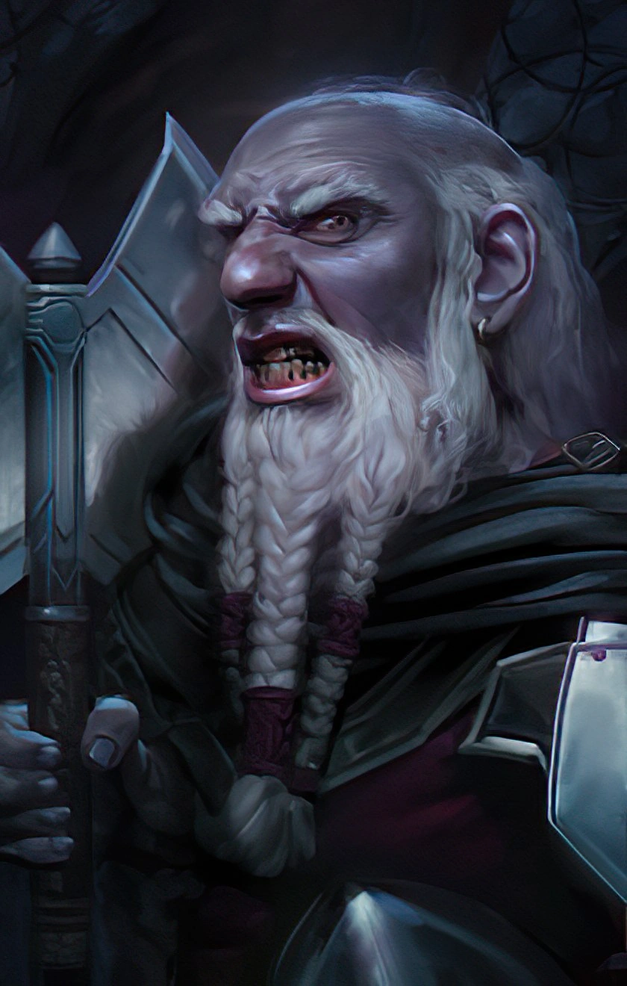

Slide 27
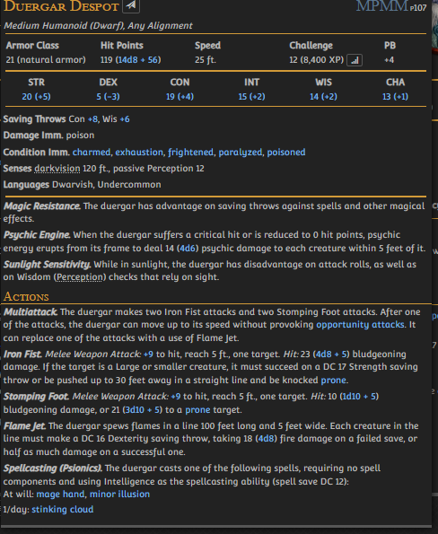
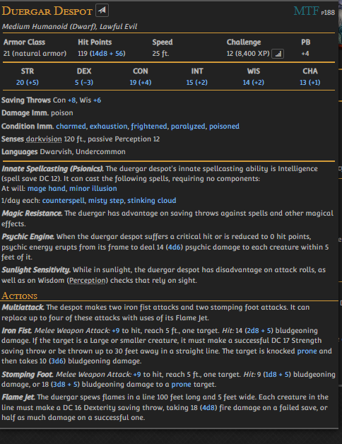

Slide 28
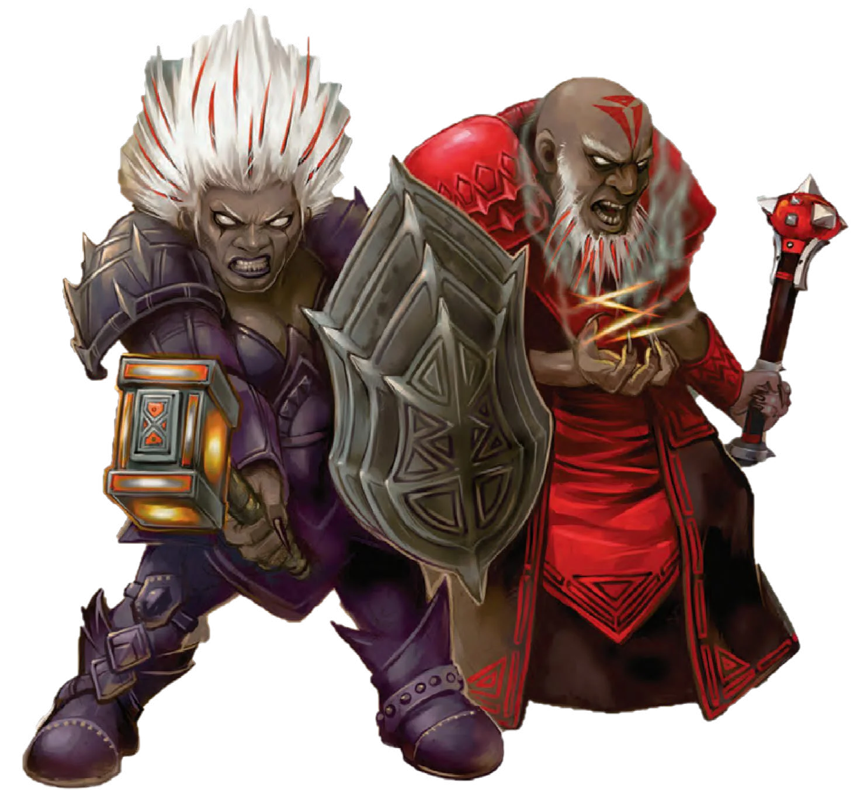
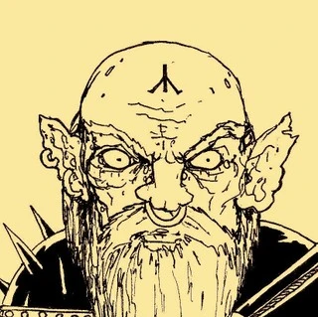

Slide 29
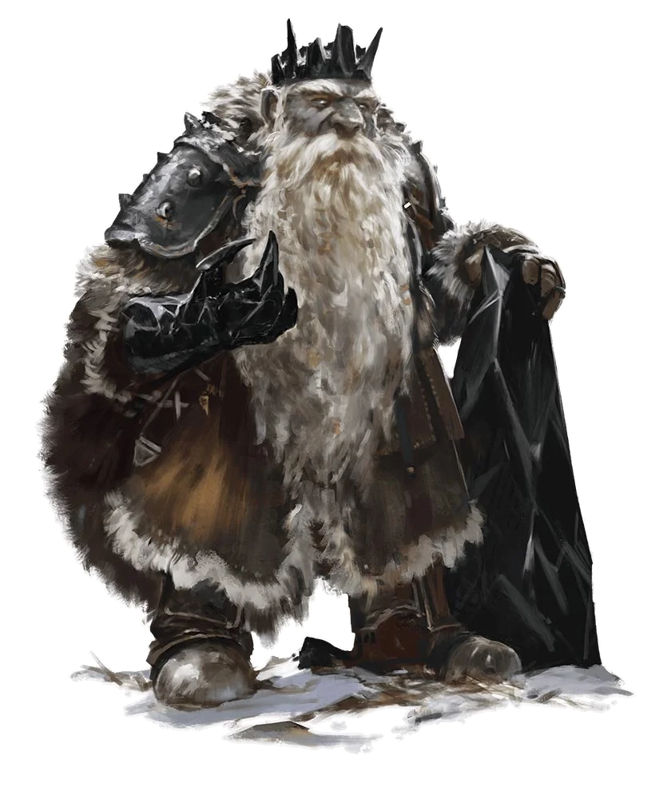
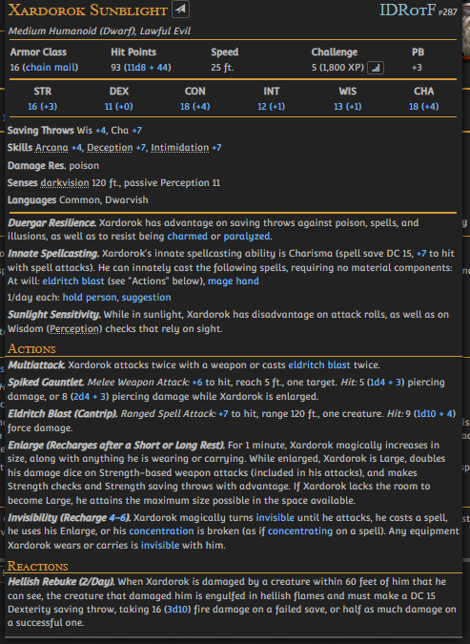

Slide 30
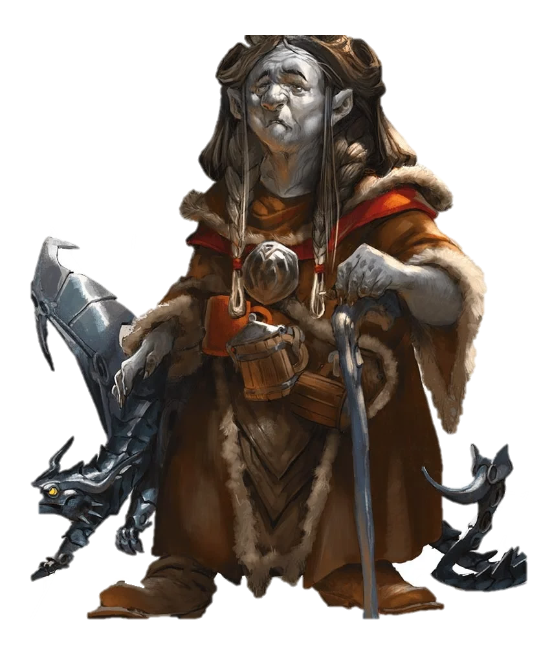
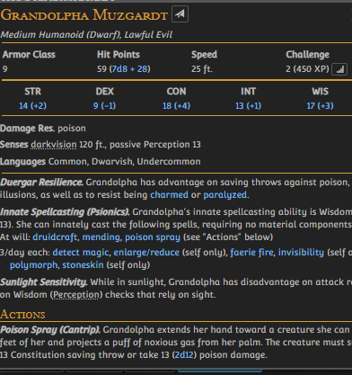

Slide 31
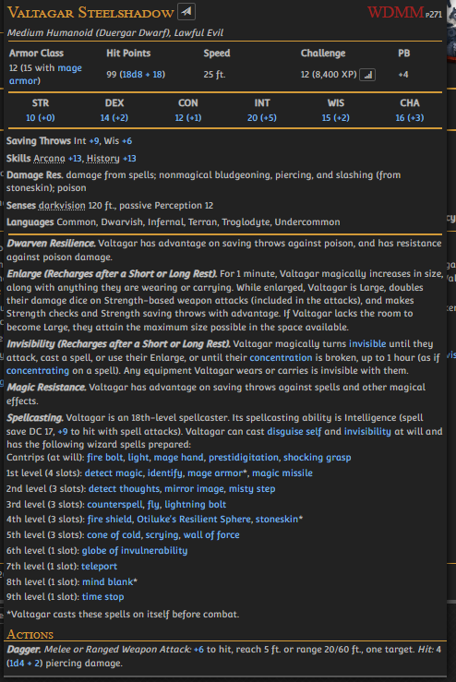
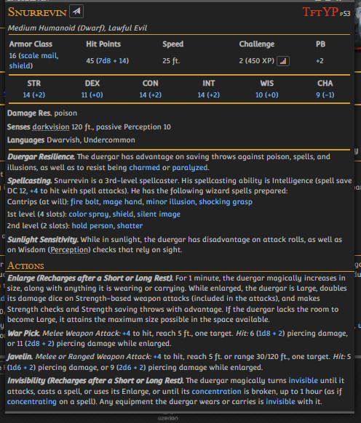

Slide 32
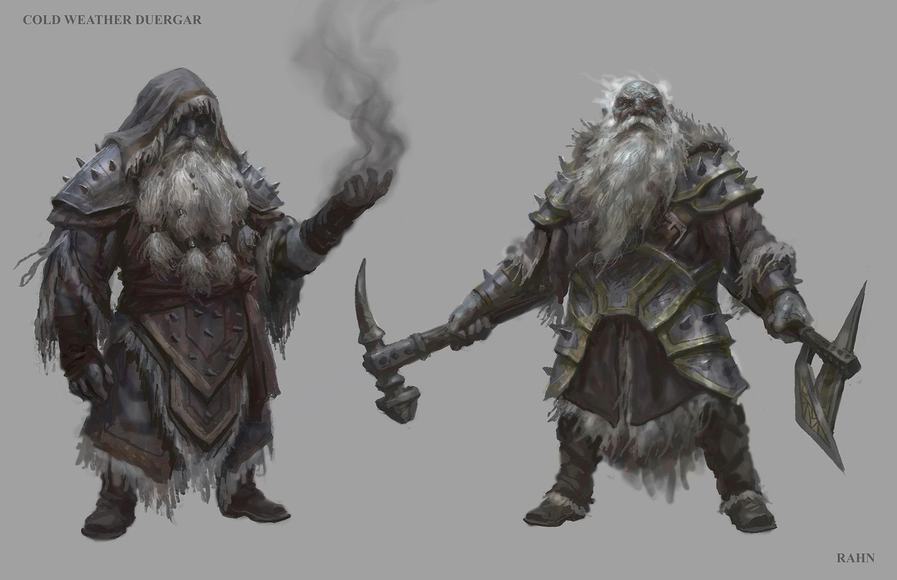

Slide 33
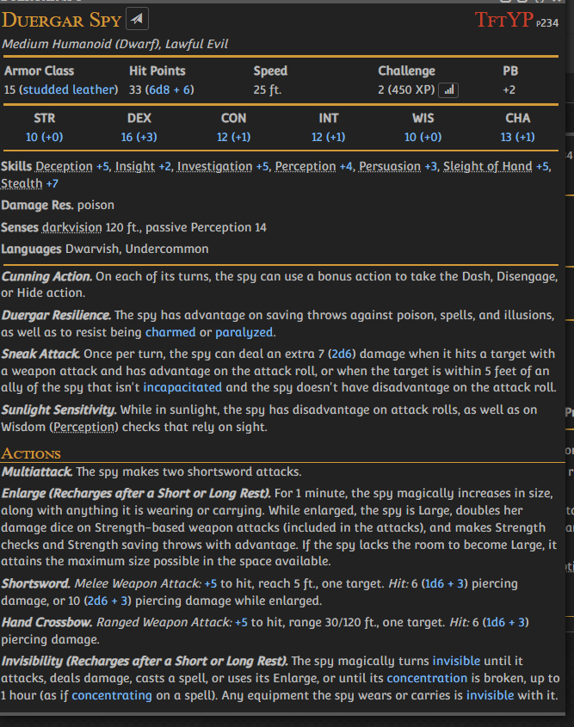
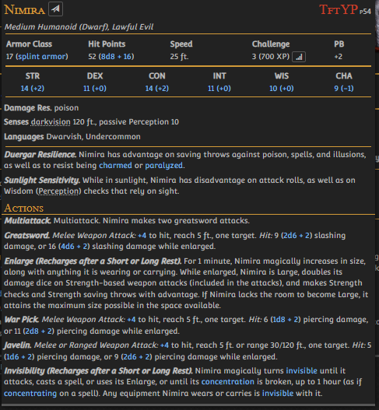

Slide 34



Slide 35


Slide 36



Slide 37


Slide 38



Slide 39



Slide 40


Slide 41



Slide 42



Slide 43



Slide 44



Slide 46


Slide 47




Slide 48

GRACKLSTUGH

Slide 49



Slide 50

UNDERDARK

Slide 51

GRACKLSTUGH

Slide 52


Slide 53


Slide 54



Slide 55


Slide 56


Slide 57


Slide 58


Slide 59


Slide 60



Slide 61


Slide 62


Slide 63


Slide 64



Darklake

Slide 65



Slide 66




DARKLAKE
Darklake Brewery
The Shattered Spire
Darklake Docks
Hall of
Sacred Scrolls
Darklake District
Overlake Hold
Gholborn’s Lair
Laduguer’s Furrow
West Cleft District
Cairngorm
Cavern
East Cleft District
Derro Slums
Hold of
The Deepking
Themberchaud’s Hoard

Slide 67

Darklake District

